Slide 1
Database
Shyam khatiwada

Slide 2
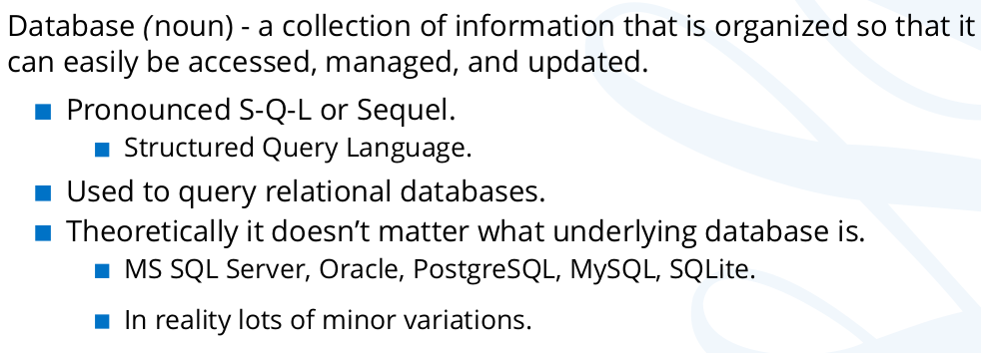
Database:

Slide 3
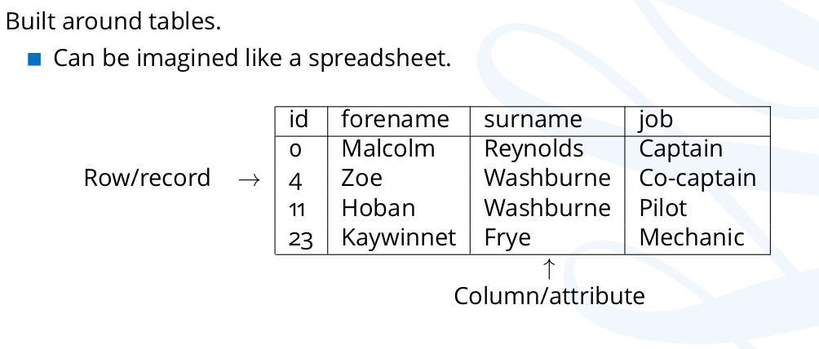
Relational database- row and column

Slide 4
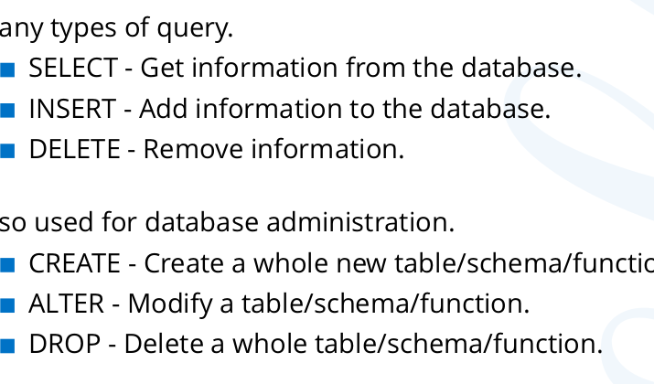
Database...

Slide 5
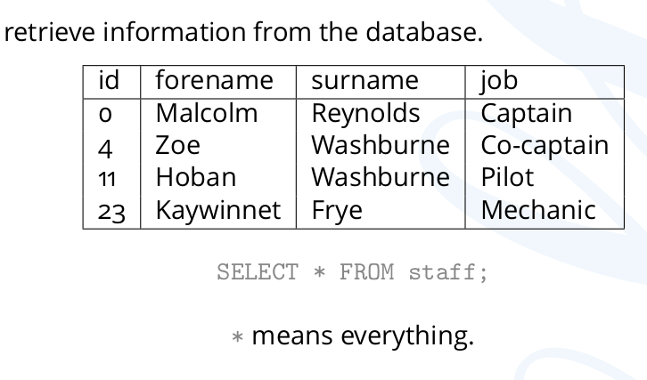
SELECT statement

Slide 6
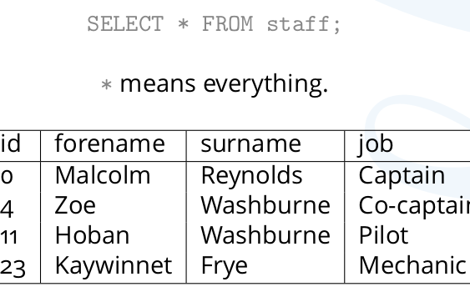
SELECT

Slide 7
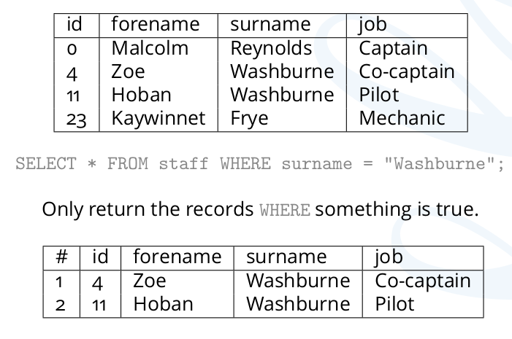
SELECT-for specific record

Slide 8
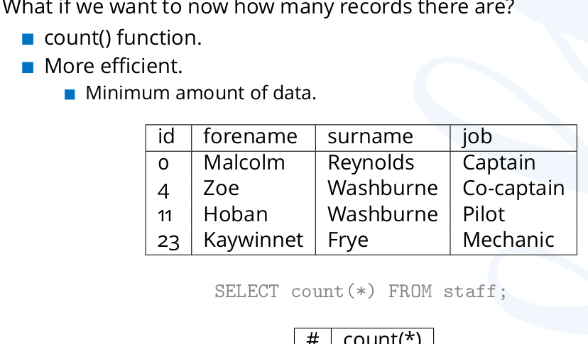
COUNT function:

Slide 9
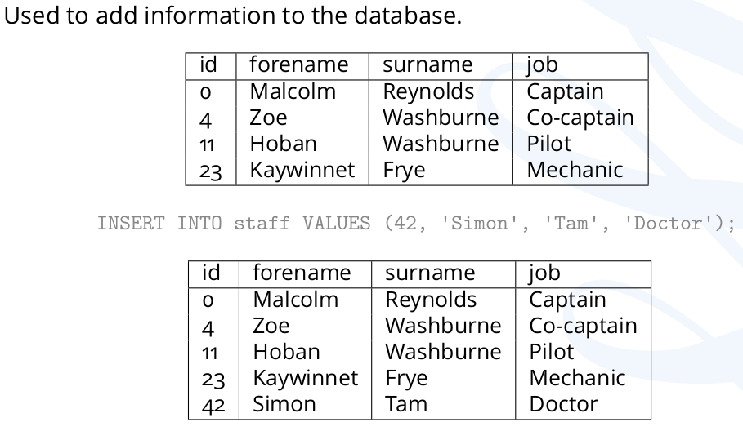
INSERT Statement

Slide 10
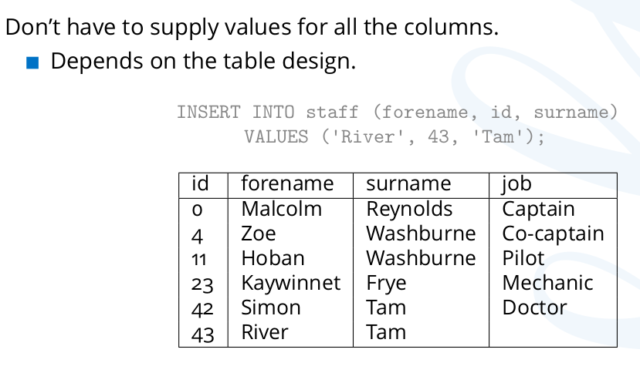
INSERT statement

Slide 11
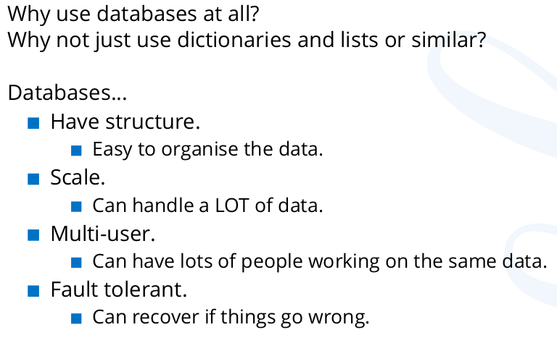
Necessity of Databases-

Slide 12
Prerequisites for Python Database Connectivity-
Latest version of MySQL installed on your computer.
MySQL workbench IDE for user interface to MySQL .
Python IDE ( PyCharm)
MySQL Connector

Slide 13
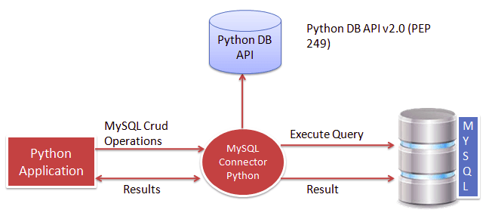
Python MySQL Database Programming

Slide 14
Python DB API-
Total 5 modules available in python to communicate with a MySQL and provides MySQL database support to our applications.
MySQL Connector Python
PyMySQL
MySQLDB
mysqlclient
OurSQL

Slide 15
You can choose any of the above modules as per your requirements. The way of accessing the MySQL database remains the same. I recommend you to use any of the following two modules:-
MySQL Connector Python
PyMySQL
Note: This tutorial based on MySQL Connector Python module.
MySQL Connector Python has the following advantages: –
MySQL Connector Python is written in pure Python, and it is self-sufficient to execute database queries through python.
It is an official Oracle-supported driver to work with MySQL and python.
It is Python 3 compatible, actively maintained.

Slide 16
Installing MySQL connector using pip
There are different ways to install MySQL connector python:
If you use PyCharm IDE -
Go to the setting
Project
Project interpreter
Pip
Search –> mysql-connector
Click install
We can install using command prompt using command.

Slide 17
Steps to connect mysql:
Import
Import mysql.connector
Create
Create the connection object
Create
Create the cursor object
Execute
Execute the query
Close
Close the cursor
Close
Close the connection

Slide 18

1. import database module:
Import mysql.connector
This line imports the MySQL Connector Python module in your program so you can use this module’s API to connect MySQL.
Also import Error object
from mysql.connector import Error
mysql connector Error object is used to show us an error when we failed to connect Databases or if any other database error occurred while working with the database. Example ACCESS DENIED ERROR when username or password is wrong.

Slide 19
1. Code:
Import mysql.connector
from mysql.connector import Error

Slide 20
2.Create the connection object:
Use the mysql.connector.connect() method with required parameters
Required parameters:
Username – i.e., the username that you use to work with MySQL Server. The default username for the MySQL database is a root
Password – Password is given by the user at the time of installing the MySQL database. If you are using root then you won’t need the password.
Host Name – is the server name or Ip address on which MySQL is running. if you are running on localhost, then you can use localhost, or it’s IP, i.e. 127.0.0.0
Database Name – Database name to which you want to connect

Slide 21
2. Code:
Connection=mysql.connector.connect(host='localhost', database='database_name', user='root', password='')

Slide 22
mysql.connector.connect()
Using this method we can connect the MySQL Database, this method accepts four required parameters: Host, Database, User and Password that we already discussed.
connect() method established a connection to the MySQL database from Python application and returned a MySQLConnection object. Then we can use MySQLConnection object to perform various operations on the MySQL Database.
The Connect() method can throw an exception, i.e. Database error if one of the required parameters is wrong. For example, if you provide a database name that is not present in MySQL, then Python application throws an exception. So check the arguments that you are passing to this method.

Slide 23
3. Create the Cursor object:
Use <Connection object>.cursor() method
This method returns a cursor object. Using a cursor object, we can execute SQL queries.
The MySQLCursor class instantiates objects that can execute operations such as SQL statements.
Cursor objects interact with the MySQL server using a MySQLConnection object.

Slide 24
Code:
Cursor = connection.cursor()

Slide 25
4. Execute the query:
Use the <cursor object>.execute() method
This method is used to execute different SQL query and we pass query as the arguments.
Required argument:
Query statement- insert, update, create, delete, select etc.

Slide 26
4. Code:
Cursor.execute("select database;")

Slide 27
Execute Method:
<Cursor object>.execute(sqlquery) method – it is used to execute the single query.
<Cursor object>.executemany() method – it is used to execute parameterized query.

Slide 28
5. Close the cursor object:
Use <cursor object>.close() method
No arguments is required.
Using the cursor’s close method we can close the cursor object. Once we close the cursor object, we cannot execute any SQL statement.

Slide 29
6. Close the Connection object:
Use <Connection object>.close() method.
No arguments required.
At last, we are closing the MySQL database connection using a close() method of MySQLConnection class.

Slide 30
5 and 6. Code:
Cursor. close()
Connection. close()

Slide 31
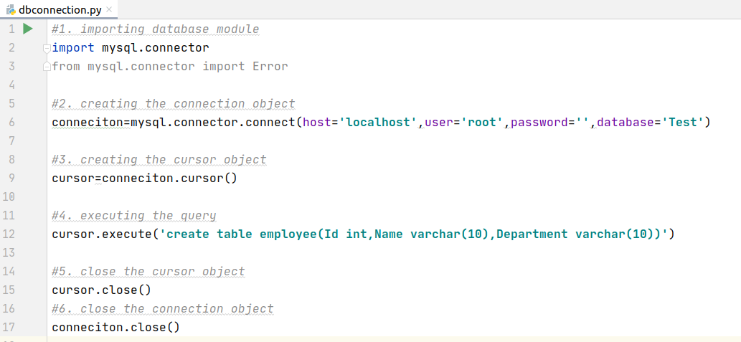
Database connection with create query:

Slide 32
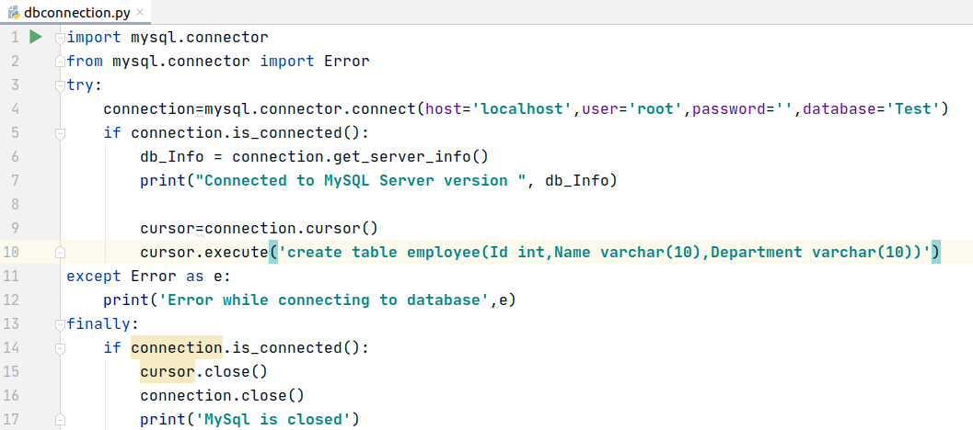
Connection code with Handling Error

Slide 33
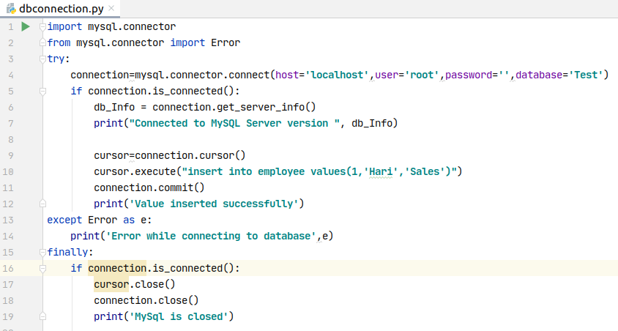
MySQL insert:

Slide 34
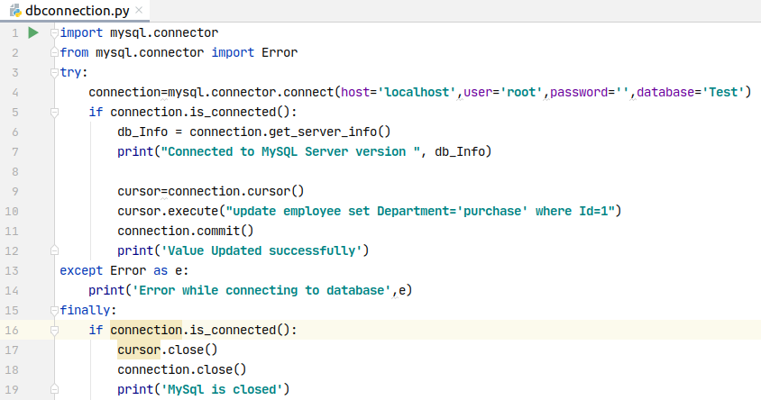
MySQL Update:

Slide 35
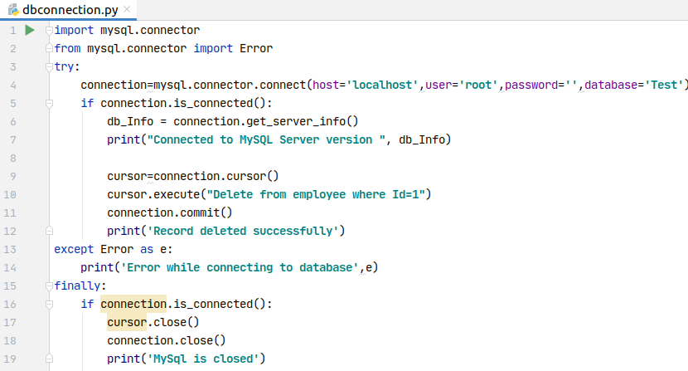
MySQL Delete:

Slide 36
MySQL select
Executing select Query is different from other statement because unlike others select query will select and returns the data.
So inorder to receive the data and fetch them we must make a variable to hold the data and call the fetch method.
fetchone() - to fetch single record
fetchall() - to fetch all the record
fetchmany(n) - to fetch n numbers of record.
cursor.execute('select query')
Records=cursor.fetchall()

Slide 37
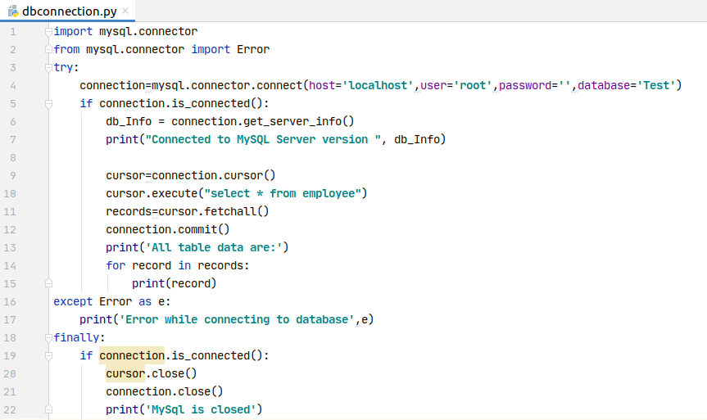
MySQL select:

Slide 38
Parameterized Query in Python:
A parameterized query is a query in which placeholders used for parameters and the parameter values supplied at execution time. That means parameterized query gets compiled only once.
Let’s see the example of a parameterized query:
sql_parameterized_query = """Update employee set Salary = %s where id = %s"""
As you can see, we are passing a parameter (%s) for the values. You must supply values in place of the placeholders (%s) before you can execute this query using a Prepared Statement. Here we provide python variables at the position of the placeholder.
Sometimes it is more convenient to use a parameterized Query or prepared statement for sending SQL queries to the database.

Slide 39
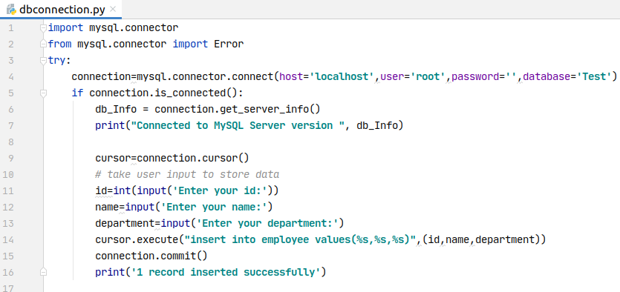
Code:

Slide 40
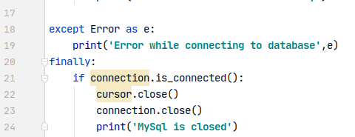
Code:
Format:
Query='select * from employee where id=%s'
We must pass the value at the time of calling execute method.
Cur.execute(Query,(value,))
Remember: value must be passed in the form ot tuple and If there is single value, don't forget to mention comma.

Slide 41
Task 1 Database:
Create a console application that performs CRUD operation on the database.
First create database and table in MySQL.
Database name --> softwarica
Table name --> Student
Perform insert, update, delete and retrieve(select) operation.
Try to make menu driven program.
Note: solution is available in LMS

